Slide 1


Student Organization form submission Training
Fall 2023

Slide 2
Overview
Partnership with Student Life
Student Organization Approvals
RSO Forms
Approval forms
Funding Request
Purchasing
Budgets
RSO Travel
DTS

Slide 3

Student Organizations
Student Life
Advisors
Organization members

Slide 4

Student Organization Approvals
Always allow 2 weeks for approval
Allow 3 weeks for approval when traveling
Printing requests may be sent to studentactivities@odessa.edu 2 weeks prior to needing the material
You may fill out our RSO approval forms at odessa.edu and submit them under the form tab
All approval forms must be submitted by advisors
Funding requests must be done during Fall and Spring semesters only!
One day notice will not be accepted

Slide 5

Student Organization Approvals
Host an event on campus
Hosting an event off campus
Fundraisers
Trips out of town
Trips in town
Service projects
Post flyers

Slide 6

RSO Forms
ALL POLICIES AND RULES OUTLINED IN RSO HANDBOOK
Section 5: MEETINGS, EVENTS AND ACTIVITIES
All forms can be accessed online via the Odessa College Website. These forms include the following:
Organization Registration/Officer Contact Sheet
Event Approval Form
Fundraiser Approval Form
Service Activity Approval Form
Travel Approval Forms
SGA Fund Request Forms
All forms must be submitted via email to studentactivites@odessa.edu
Forms submitted by students, unless otherwise instructed by the Director of Student Activities, will be rejected.

Slide 7
RSO Forms
ALL POLICIES AND RULES OUTLINED IN RSO HANDBOOK
MEETINGS
All student organizations are encouraged to establish a schedule of regular meetings and are required to let the Director of Student Activities know their meeting day/time no later than 3 weeks into each Fall/Spring semester. They should publicize the dates, times, and locations of these meetings. Organization advisors must make room arrangements on their own unless assistance from the Director of Student Activities is requested. MEETINGS SHALL BE OPEN TO ALL INTERESTED MEMBERS of the college community whether or not they are, or intend to be, members of the club.
ORGANIZATION ACTIVITIES and EVENTS
All events must be approved before hosting the event. All forms for event approval must be submitted 3 weeks before the event via Blackboard. Failure to submit an “Event Approval Form” prior to an event will result in a denial of the use of campus facilities for that event and possible loss of recognition as a Registered Student Organization.

Slide 8
Event Approval
Student Role
Advisor Role
Students should decide event needs
Students should take responsibility for all planning
Work orders should be submitted no later than 1 week prior to event
Coordinate and confirm with special guests/presenters before advertising, and prior to the event
Submit work orders for event logistics no later than 1 week prior to event
Approve flyers before sending to Student Life
Submit approval forms
Attend each meeting
Attend each event
Guide, mentor, advise all student organization needs
Purchasing Role
  Contracts (when applicable)
  Must be signed by Purchasing Office
  Tech Riders must be signed by the Purchasing Office
  Students and advisors may not sign any documents

Slide 9
RSO Events
“Event” applies to any organized activity that is not a regularly scheduled or officer’s meeting
01
Events should be in line with organization mission and goals
02
Members/Officers bear primary responsibility for event planning, approval, and publicity
03

Slide 10
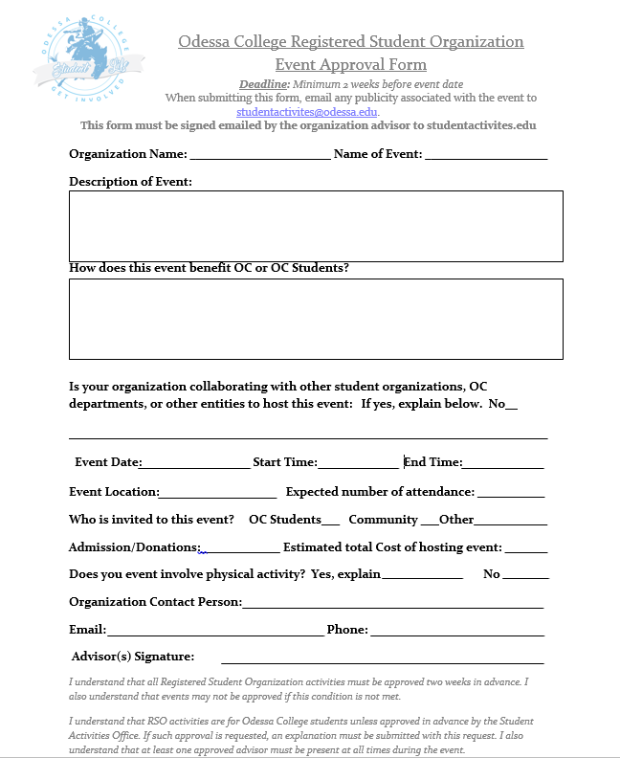

EVENT Approval FORM

Slide 11
Community Service / Volunteering
Service Projects/Volunteer Efforts follow the same approval guidelines as fundraisers
  Submit approval form 2 weeks in advance
  Approval through Student Activities, Student Life, and Institutional Advancement
Special consideration for projects in response to major events
Service projects which include raising money WILL be counted as fundraiser
Don't forget to award DTS points

Slide 12


Funding Request

Slide 13
Funding Request
You may access funding request form in the Odessa College SGA webpage
Submit funding request to studentactivities@odessa.edu
Active RSO’s may apply for SGA funding up to 3 times in an academic year
Must submit form in a timely matter prior to needing the funds
Funds used for purchasing promotional material may take approximately 3 weeks.
SGA funds may not be used for profit
SGA funds may be used for
  Traveling
  Promotional material
  Hosting an event
  Organization supplies

Slide 14
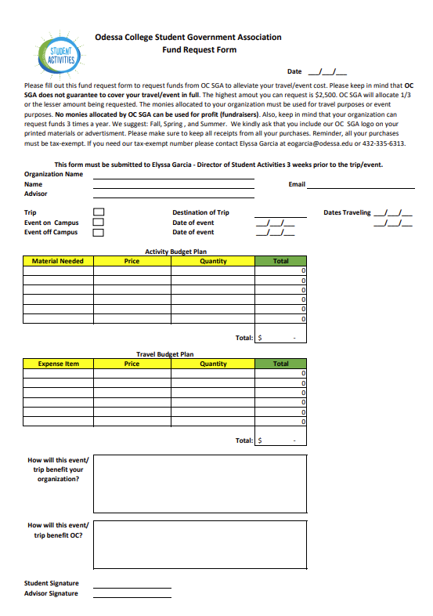
Sga funding request

Slide 15
Purchasing
RSO must request and be approved for funds BEFORE making purchases
  Purchases made without approval will not be eligible for reimbursement
  Always check with the Student Activities Director before purchasing items
Complete all purchases through RSO Agency Accounts
All purchases must be tax exempt
Submit copies of receipts/invoices to Student Activities for reimbursement
  Applies to personal reimbursements, and all OC Purchasing Card purchases
  Purchase Order and Direct Pay requests must be initiated and approved by Student Activities Office

Slide 16
Budgets
Groups have budget funds & fundraised funds
ALL Funds must be maintained through OC Business Office
  NO External Bank Accounts Permitted – No Venmo, Paypal, Cashapp, Zelle, etc.
Submit complete budget packet by given deadline for consideration
Allocations based on total requests and available funds
  Allocated amount may differ from requested amount
  More active groups may receive preference, if necessary
  Groups not in compliance with RSO attendance policy will not be considered

Slide 17

Organization Fundraising
RSOs may fundraise to acquire any desired funds​
OC Fundraising Policy​
  Fundraising Approval Form must be submitted at least 2 weeks prior to fundraiser​
  Organizations may hold a maximum of 2 fundraisers per semester​
  Fundraising approval runs through Student Activities, Student Life, and Institutional Advancement​
  Donations or other fundraising inquiries should be reviewed by Institutional Advancement

Slide 18
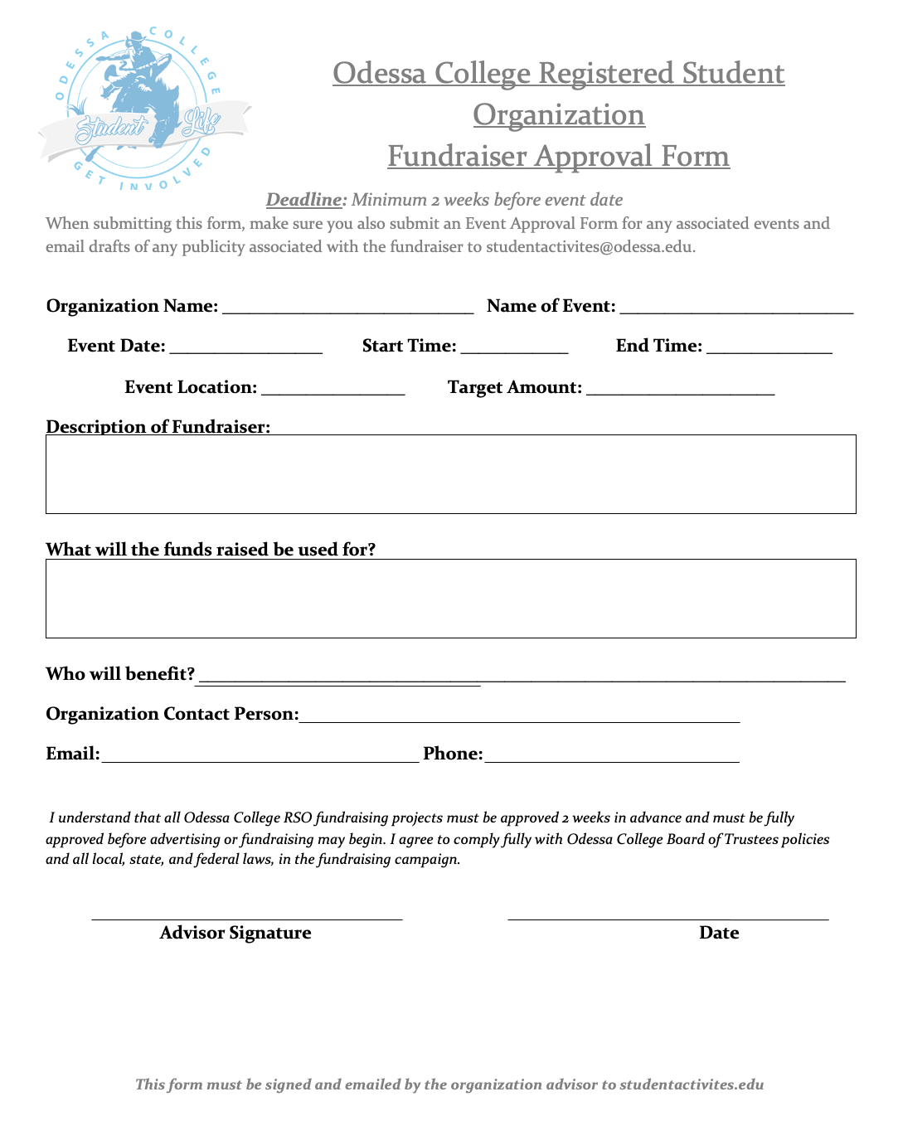
Fundraiser approval form

Slide 19
Planning Fundraisers
What is the fundraising goal?
How will funds be used?
General funds vs. philanthropy vs. specific event
Who is the target audience?
RSOs may NOT solicit businesses without prior approval
Are there incentives for donating?
Can offer goods or services
Can NOT offer cash
RSOs may NOT request donations without approval

Slide 20
Planning Fundraisers - Raffles
Most student organizations are not qualified to conduct raffles in the State of Texas. Raffles involve paying money for the chance to win a prize of greater value, which is considered gambling. Instead of raffles, it is suggested that student organizations hold “Free Drawings” in which no money is exchanged.
The Charitable Raffle Enabling Act, effective January 1, 1990, permits “qualified organizations” to hold up to two raffles per calendar year. Two types of student organizations may conduct raffles. (1) An association organized primarily for religious purpose that has been in existence in Texas for at least 10 years. (2) A nonprofit organization that has existed least the three preceding years, during which it has had a governing body duly elected by its members and is exempt from federal income tax under Section 501(c), Internal Revenue Code; does not participate in any political campaign. [A copy of your organization’s IRS Letter of Determination verifying 501c status will be required.]
Student organizations may conduct raffles on campus for qualified off-campus organizations. Raffle tickets may not be advertised statewide or through paid advertisements. Each raffle ticket must state the name and address of the organization holding the raffle, the name of an officer of the organization, the price of the ticket, and a general description of each prize to be awarded that has a value of over $10. A prize may not be money. Only members of the organization may sell tickets. No one may be compensated directly or indirectly for organizing or conducting a raffle or for selling raffle tickets
Visit https://statutes.capitol.texas.gov/Docs/OC/htm/OC.2002.htm for more information.

Slide 21

Fundraising
Individuals/Groups may NOT use buildings, properties, and facilities of the college for private or personal gain or for activities in opposition to the college's general educational purposes. With prior authorization, sales on campus are permissible by registered student organizations that desire to earn funds for future endeavors. All fundraising request must be submitted by the On-Campus Advisor at least 3 weeks before the fundraiser via Blackboard. No raffles are allowed on campus or off campus. In general, sales of any kind cannot be held if such sales interfere with normal college activity or with the operation of food services. Always contact the Odessa College Foundations office if your organization is planning a fundraiser at a restaurant.

Slide 22
After the Fundraiser
Fundraiser Evaluation Form
  Successes/Failures
  Total amount raised
  Feedback for the future
  Return form and funds to Student Activities Office within 48 hours
  Meet with Student Activities to discuss timeframe for ongoing fundraisers
  Deposit funds with the Cashiers in the Business Office (Spur 204)
  Thank your donors for contributing

Slide 23

RSO Travel
Group travel must be approved no less than two-three weeks prior to travel taking place
Advisor must also receive permission from their supervisor as well
RSO must submit a Travel Proposal Form, including full contact information for the advisor(s) traveling with the group
Must submit names and SIDs of all students traveling
Each student must submit Waiver & Release of Liability to Student Activities 2 days prior to travel
If OC funds are used, a travel budget proposal must be submitted along with the Travel Proposal Form

Slide 24

RSO Travel
While traveling with an OC RSO, students are still subject to all OC policies and procedures
When traveling, RSO members are representing all of OC and must do so in a positive manner
Possession or use of drugs/alcohol is prohibited, regardless of age
Failure to abide by OC policies or inappropriate conduct may result in revocation of travel privileges and/or disciplinary action, as necessary
All travel forms must be approved by the Vice President of Student Services and Enrollment Management – Kim McKay (kmckay@odessa.edu).

Slide 25
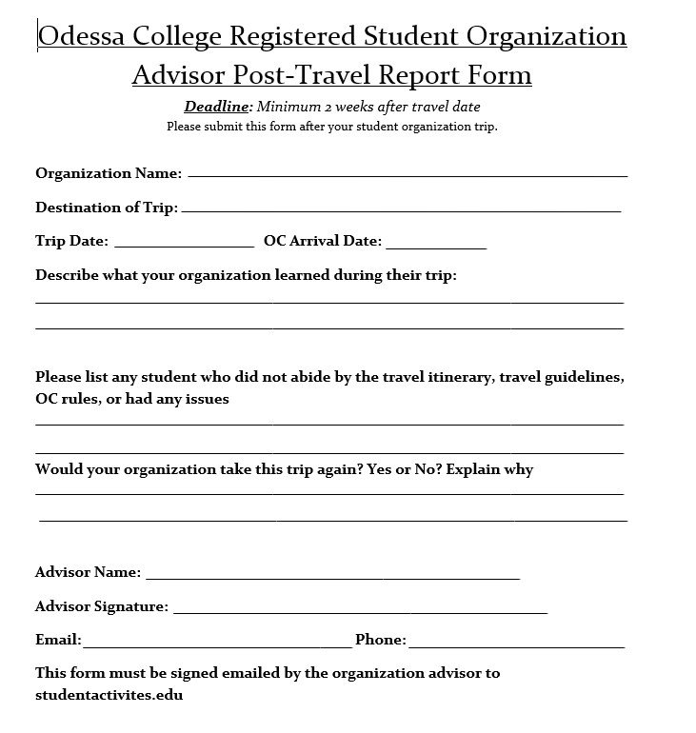
Advisor post travel report
Advisor must complete and submit post travel report after each organization trip
Gives an overview of the trip
Notifies Student Activities of any issues during the trip
Allows Student Activities to be aware of which students are eligible to continue traveling

Slide 26

Drive to success

Slide 27
Awarding DTS Points
Advisors must add each event, meeting, activity
1
Add meeting times and dates to DTS app
2
Award 5 pts per general meetings
3
Award 5 pts per officer meeting
4
Award 5 pts for events after 5pm
5
Award 2 pts for events 8am to 5pm
6
DTS Points Must be available to ALL students
7

Slide 28
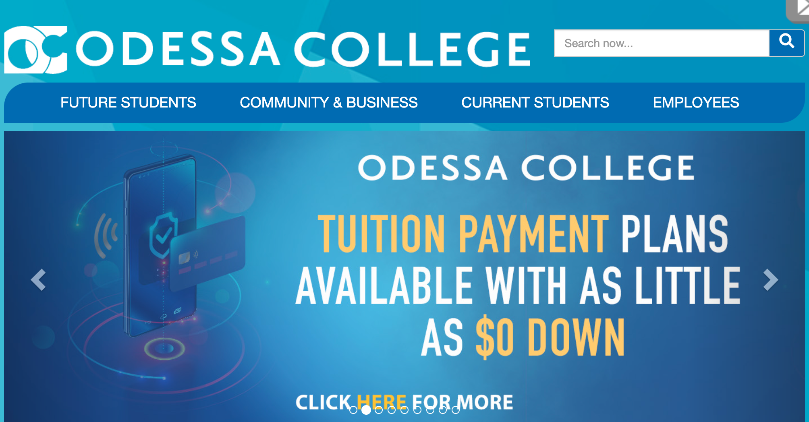
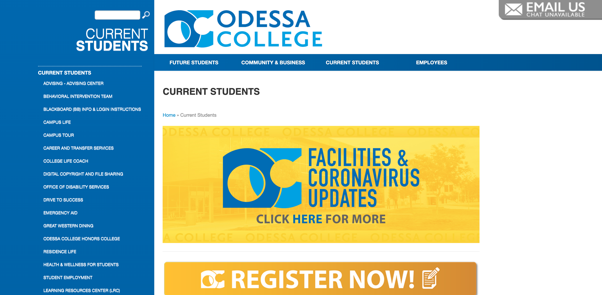

Slide 29
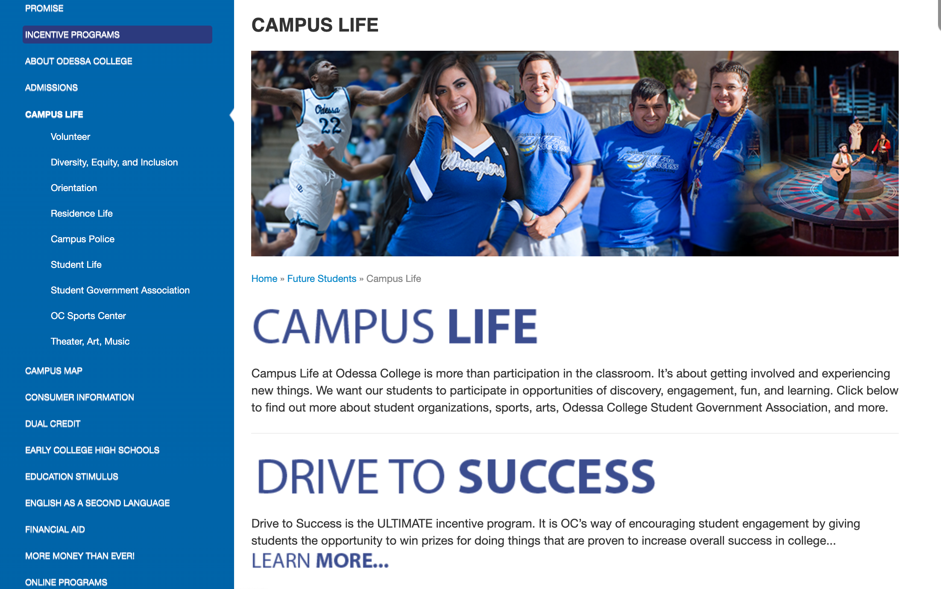
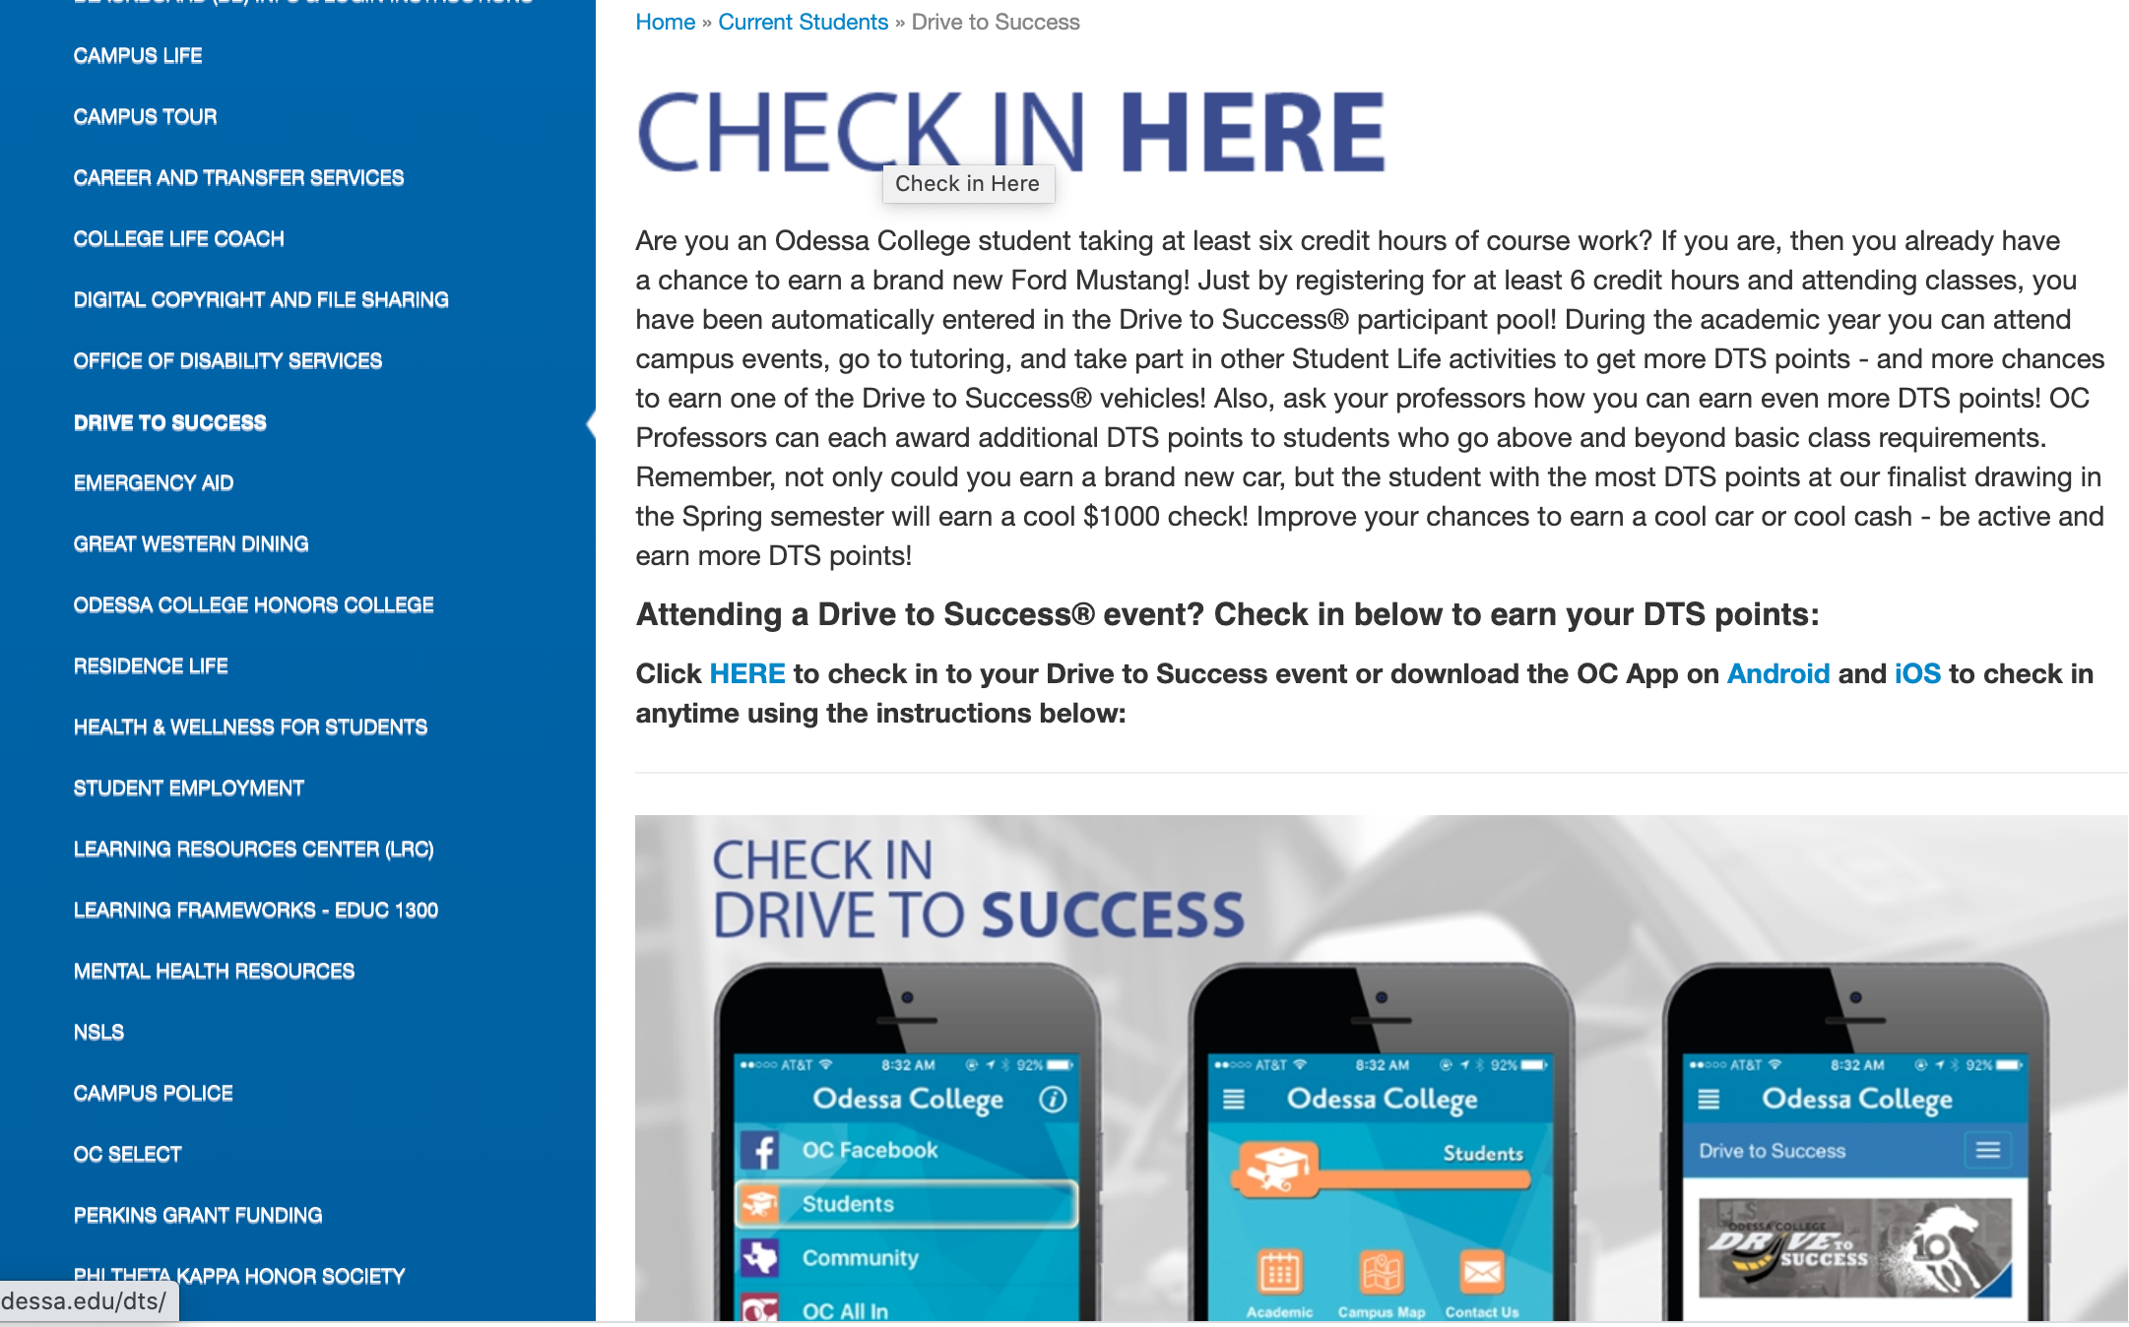

Slide 30
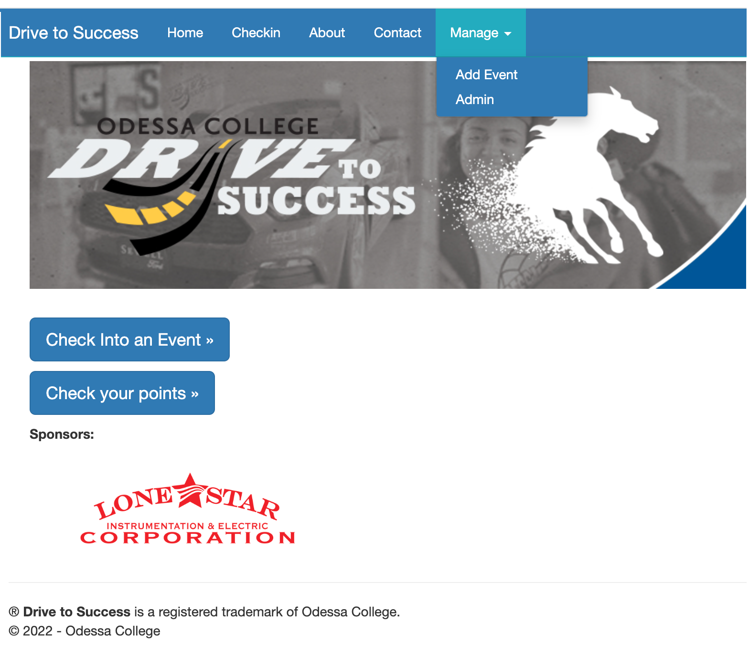
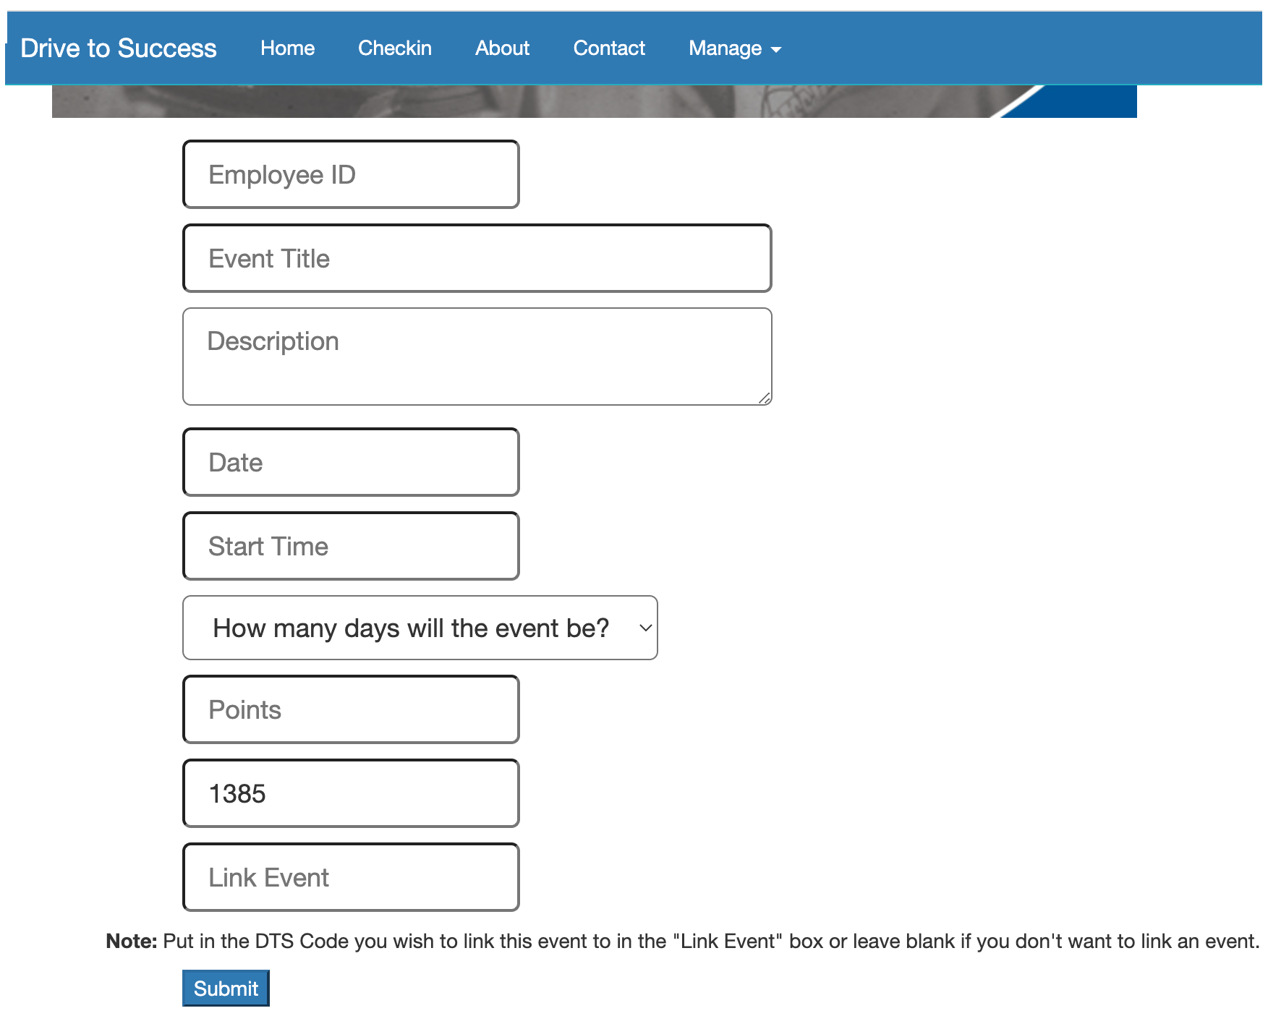

Slide 31


